Slide 1

School of Computer Science & Engg.
Offered in All Engineering U.G. Programs
Semester- 3rd Subject Code- 25CSH-211
Subject Name- Database Management System
Unit -1 Relational Model and Formal Query Languages
Chapter 1.1.2 – Relational Data Model, Keys and Integrity Constraints.
Master Subject Coordinator
Mr. Vinod Vishwakarma
(Assistant Professor)
School of Computer Science and Engineering
www.culko.in
Nawabganj, Unnao

Slide 2
Table of Contents
Relational Data Model Concept
Components of Relational Data Model
Keys
Data Integrity and Constraints
Advantages of Relational Data Model
Conclusion
Practice Questions
www.culko.in
Nawabganj, Unnao
www.culko.in Nawabganj, Unnao

Slide 3
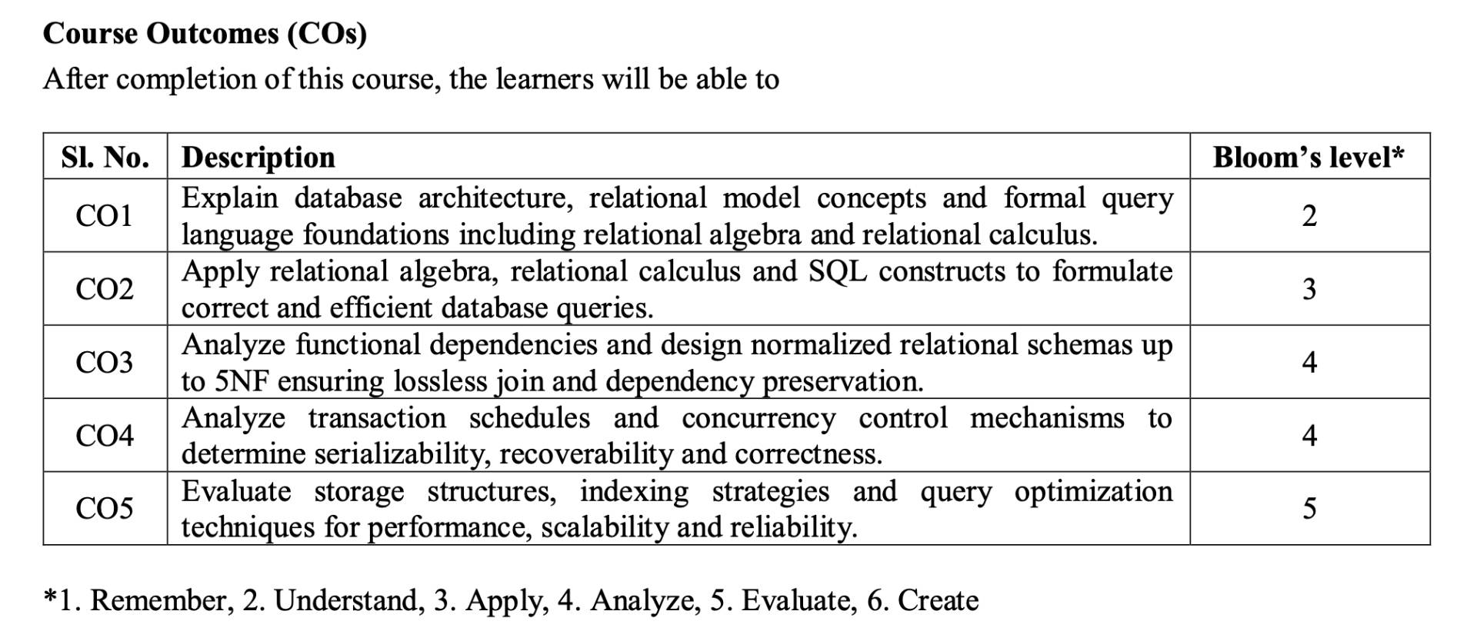
Course Outcome
www.culko.in
Nawabganj, Unnao
www.culko.in Nawabganj, Unnao

Slide 4
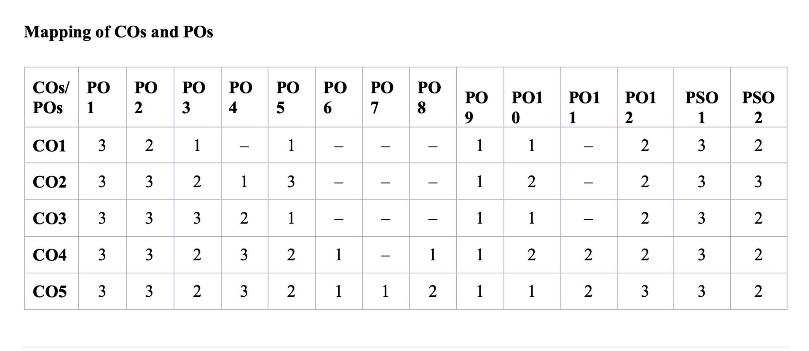
Mapping Of COs and POs
www.culko.in
Nawabganj, Unnao
www.culko.in Nawabganj, Unnao

Slide 5
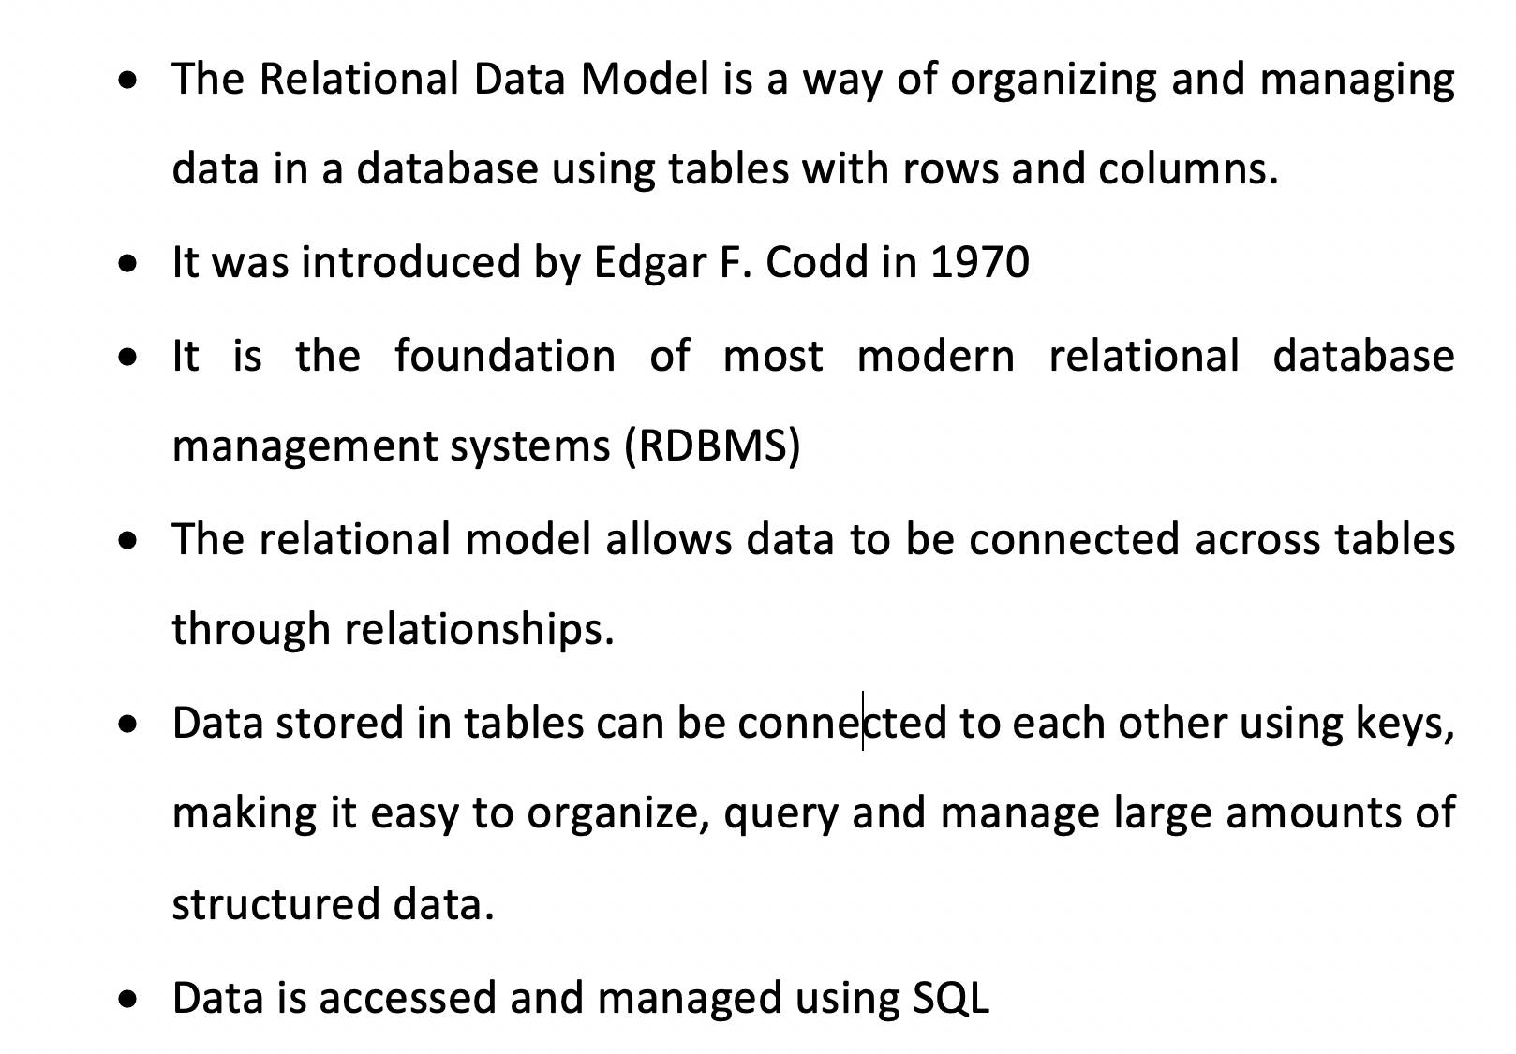
1. Relational Data Model Concept
www.culko.in Nawabganj, Unnao

Slide 6

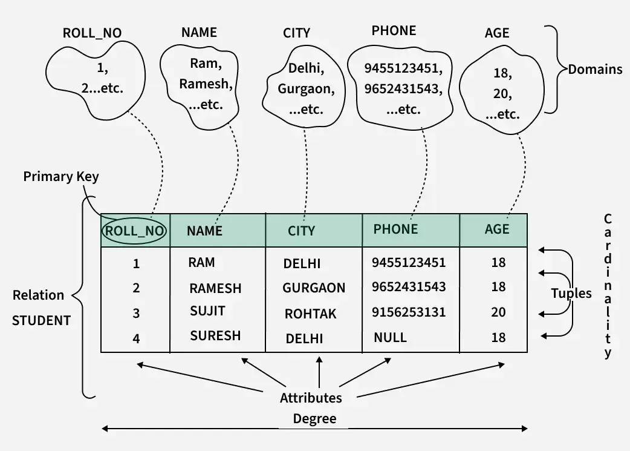
Fig.2.1
www.culko.in
Nawabganj, Unnao
www.culko.in Nawabganj, Unnao

Slide 7
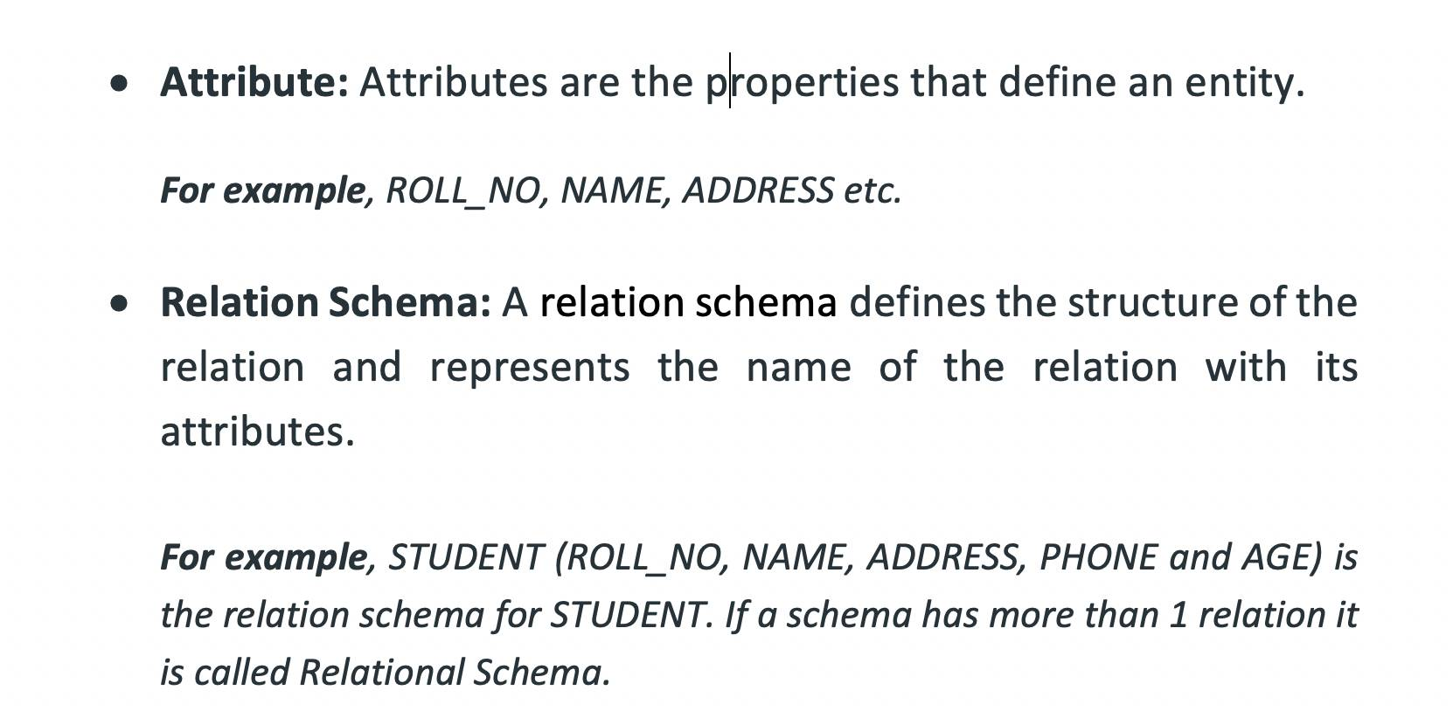
2. Components of Relational Data Model
www.culko.in
Nawabganj, Unnao
7
www.culko.in Nawabganj, Unnao

Slide 8
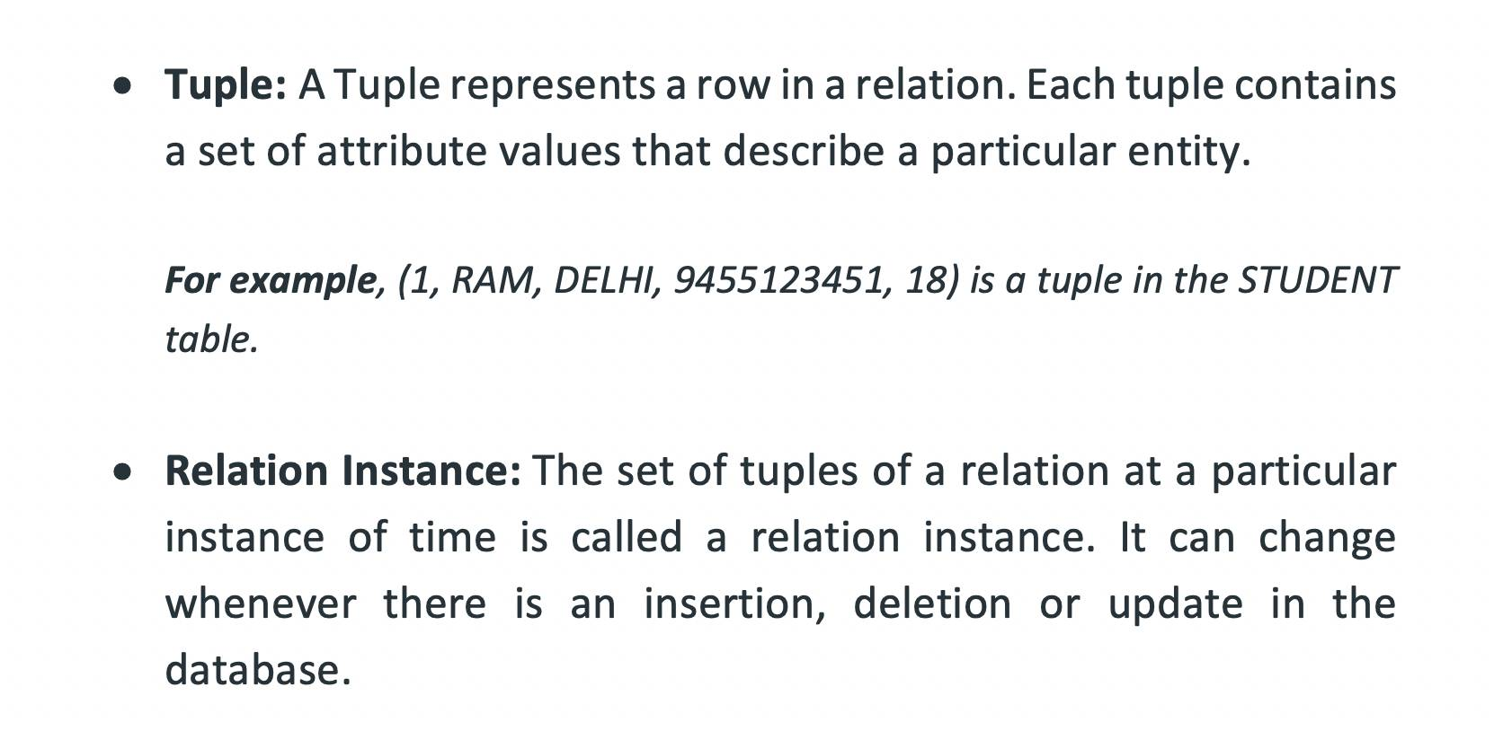
Cont.
www.culko.in
Nawabganj, Unnao
8
8
www.culko.in Nawabganj, Unnao

Slide 9
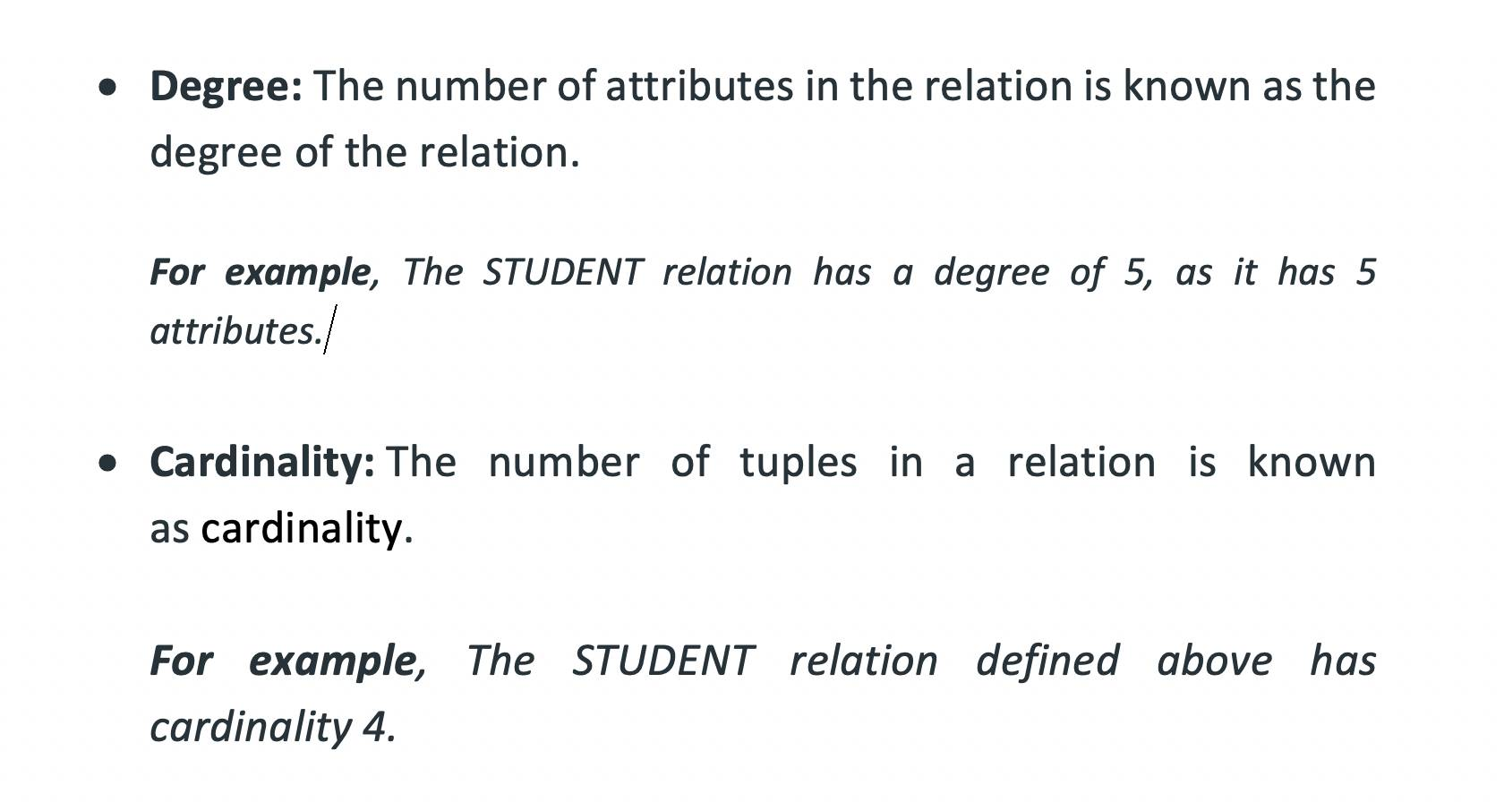
Cont.
www.culko.in
Nawabganj, Unnao
9
9
www.culko.in Nawabganj, Unnao

Slide 10
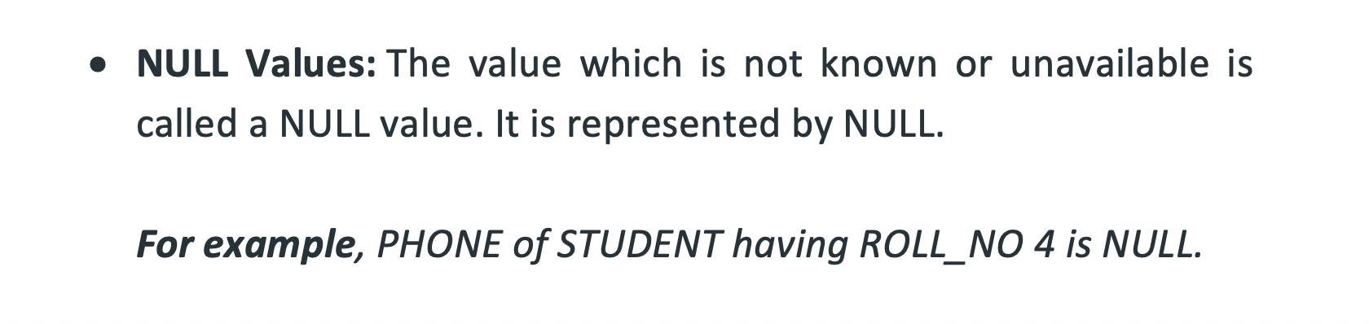
Cont.
www.culko.in
Nawabganj, Unnao
10
10
www.culko.in Nawabganj, Unnao

Slide 11
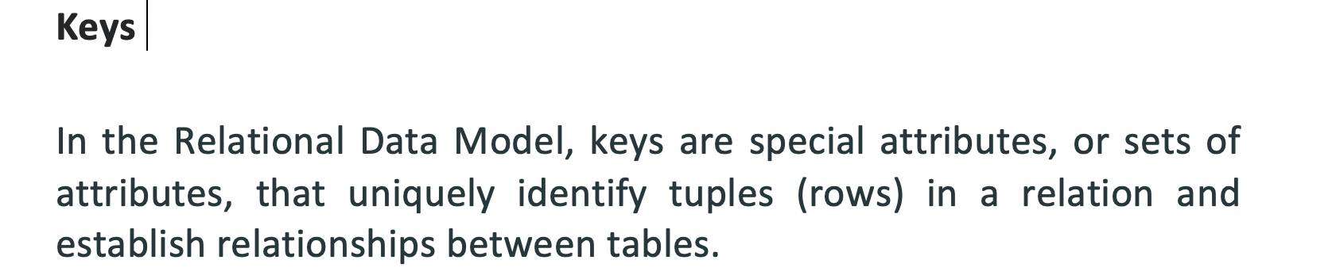
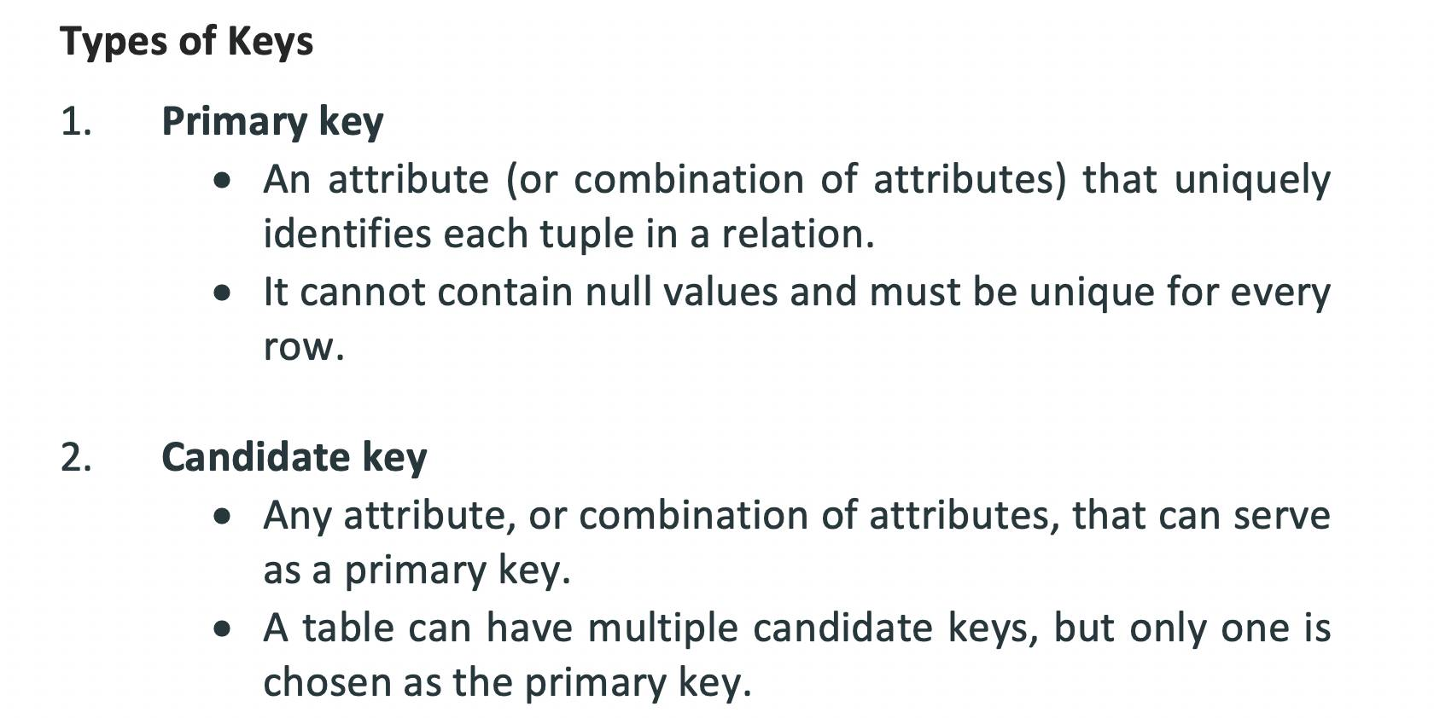
3. Keys
www.culko.in
Nawabganj, Unnao
www.culko.in Nawabganj, Unnao

Slide 12
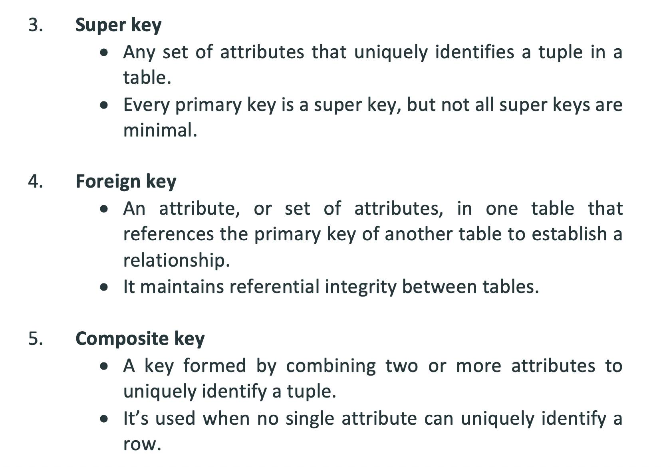
www.culko.in
Nawabganj, Unnao
www.culko.in Nawabganj, Unnao

Slide 13
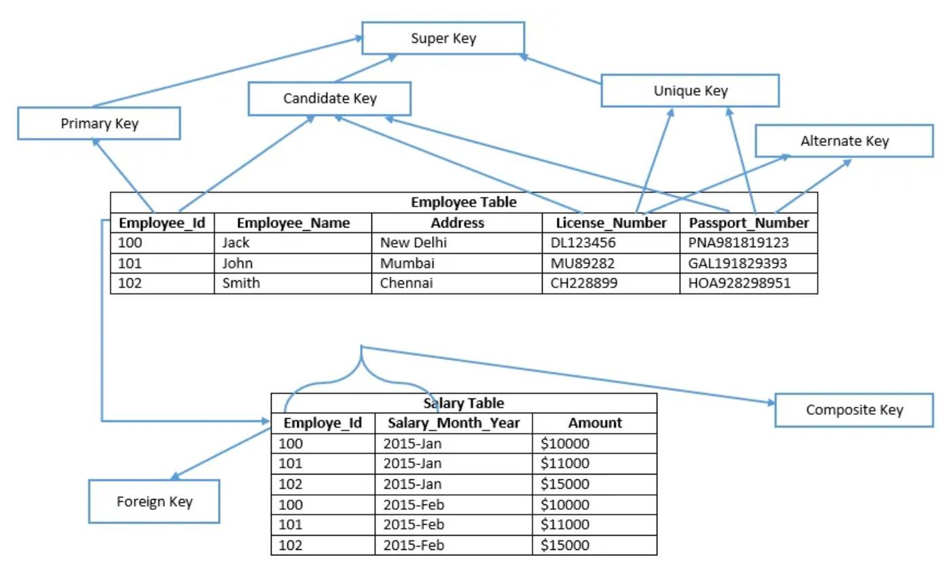
Diagram to Describe all keys
Fig.2.2
www.culko.in
Nawabganj, Unnao
www.culko.in Nawabganj, Unnao

Slide 14
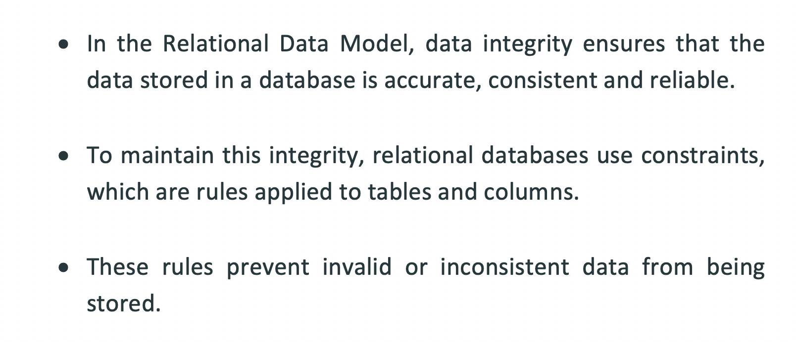
4. Data Integrity and Constraints
www.culko.in
Nawabganj, Unnao
www.culko.in Nawabganj, Unnao

Slide 15
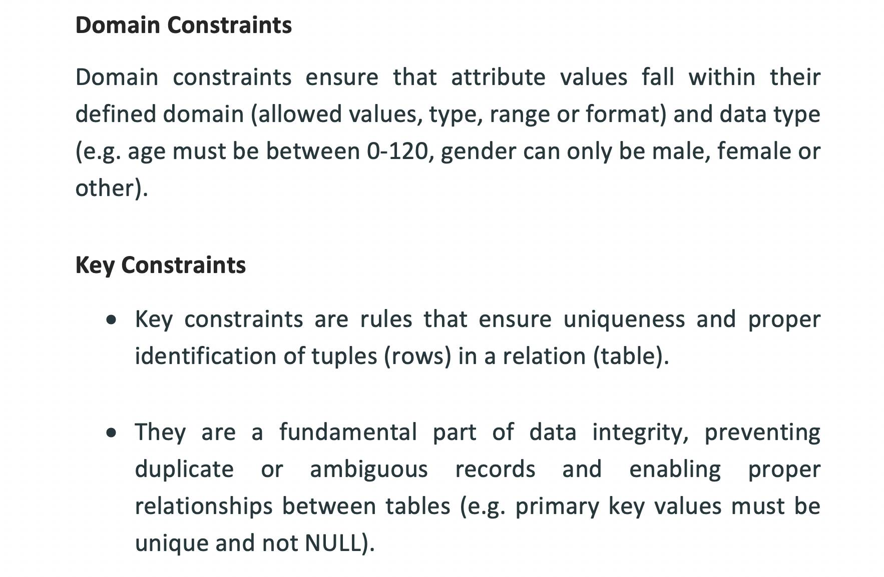
Cont.
www.culko.in
Nawabganj, Unnao
www.culko.in Nawabganj, Unnao

Slide 16
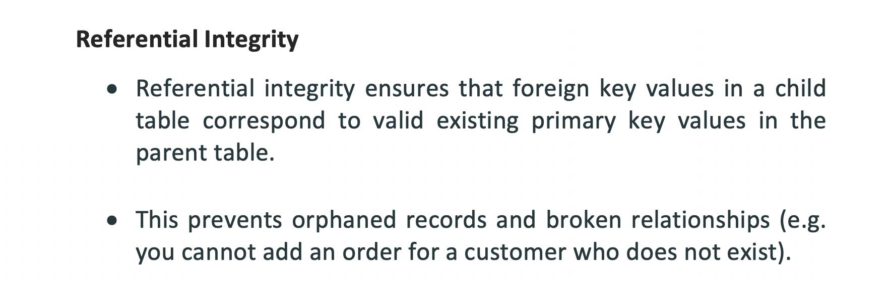
Cont.
www.culko.in
Nawabganj, Unnao
www.culko.in Nawabganj, Unnao

Slide 17
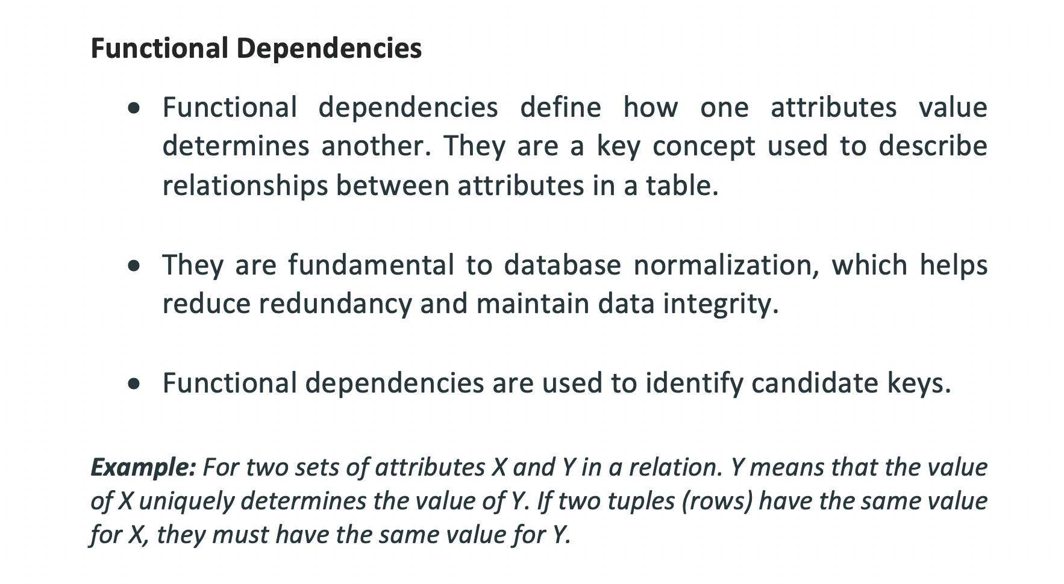
Cont.
www.culko.in
Nawabganj, Unnao
www.culko.in Nawabganj, Unnao

Slide 18
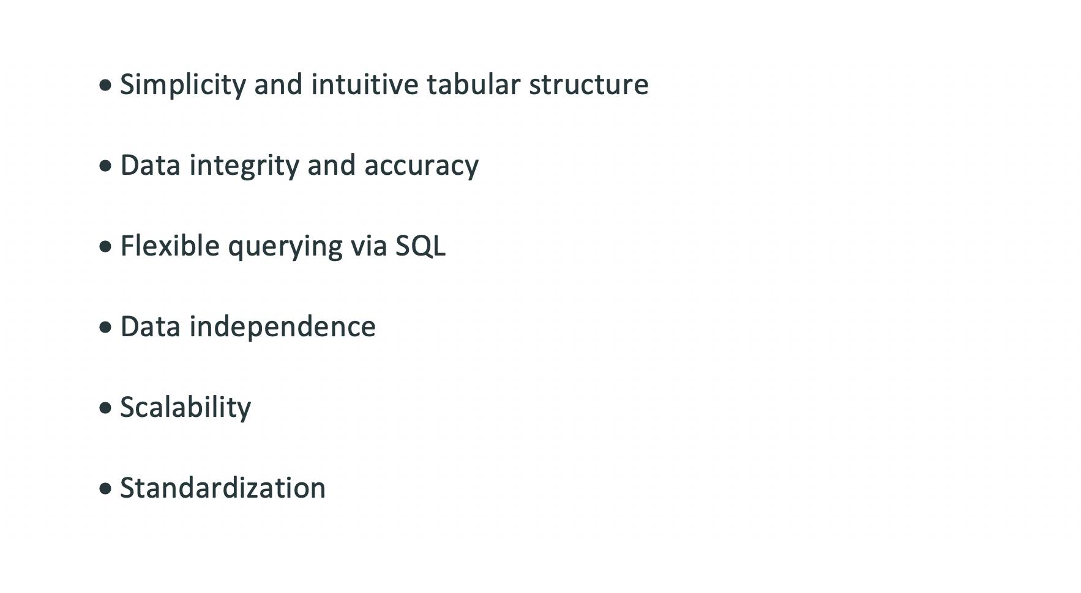
5. Advantages of Relational Data Model
www.culko.in
Nawabganj, Unnao
www.culko.in Nawabganj, Unnao

Slide 19
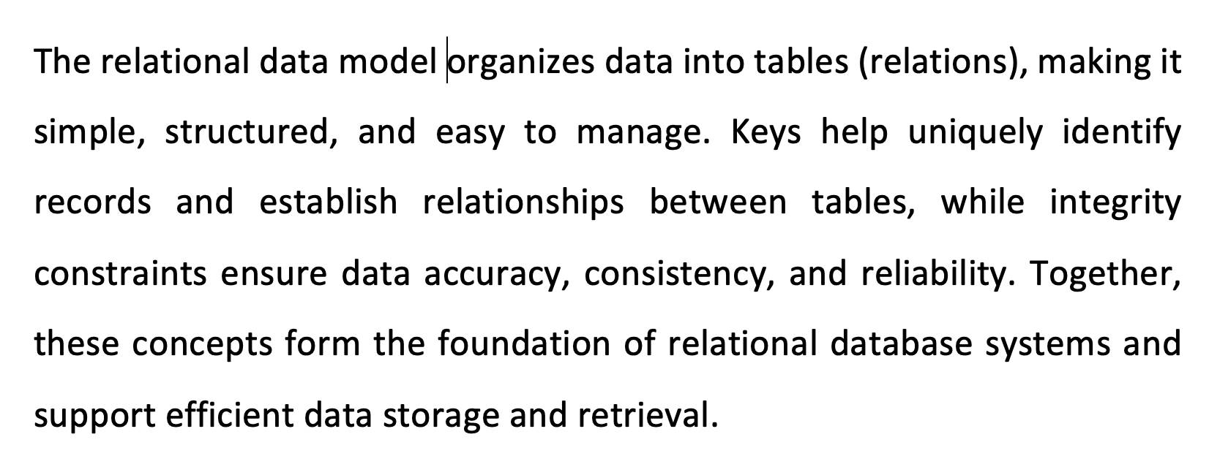
6. Conclusion
www.culko.in
Nawabganj, Unnao
www.culko.in Nawabganj, Unnao

Slide 20
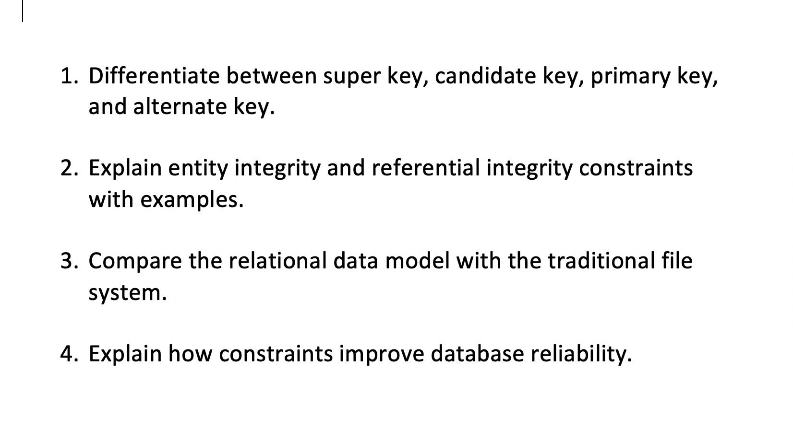
7. Practice Questions
www.culko.in
Nawabganj, Unnao
www.culko.in Nawabganj, Unnao

Slide 21
References
Elmasri, R., & Navathe, S. B. (2017). Fundamentals of database systems (7th ed.). Pearson.
Silberschatz, A., Korth, H. F., & Sudarshan, S. (2019). Database system concepts (7th ed.). McGraw-Hill..
www.culko.in
Nawabganj, Unnao
www.culko.in Nawabganj, Unnao

